Slide 1
Facebook Ads Practice Campaign
Bean & Bloom Cafe — Project Report
Campaign built and configured in Meta Ads Manager as an unpublished draft, for learning purposes.
Unified Mentor Capstone Project
Prepared by: S. Umayal
Program: Digital Marketing
Organization: Unified Mentor
Date: April – September 2026

Slide 2

Business Overview
A fictional specialty coffee shop, created for this practice campaign
Attribute | Detail
Business type | Independent specialty coffee shop
Location (fictional) | Indiranagar, Bengaluru
Core offering | Specialty coffee, handcrafted iced coffee, light bakes
Campaign offer | 20% off first handcrafted iced coffee
Brand personality | Warm, cozy, community-focused
Bean & Bloom Cafe — Facebook Ads Practice Campaign
2

Slide 3
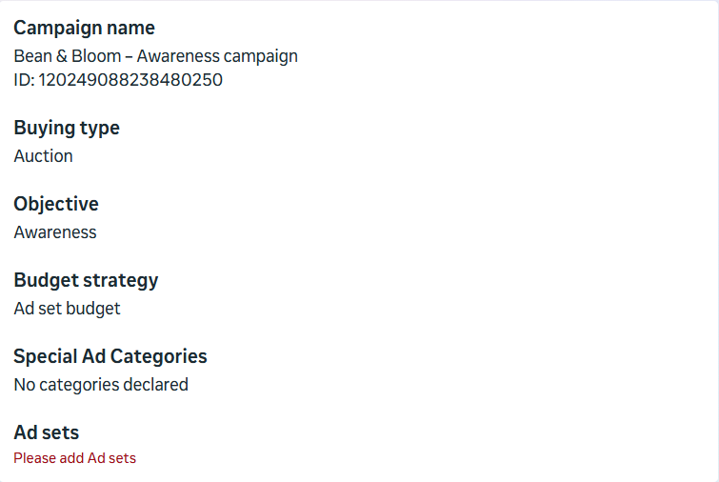
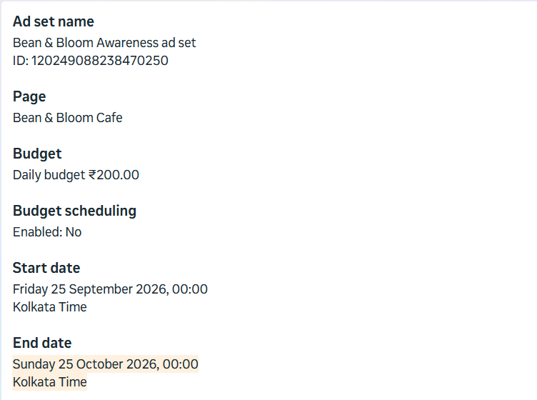
Campaign Setup: Objective, Budget & Bid
As configured in Meta Ads Manager (screenshots)
Objective: Awareness — chosen to build local brand recognition (Traffic was already covered in a separate course).
Budget: ₹200/day, running for 30 days (Sep 25 – Oct 25, 2026), Ad Set budget strategy.
Bid strategy: Highest volume — Meta's default for maximizing reach within budget.
Bean & Bloom Cafe — Facebook Ads Practice Campaign
3

Slide 4
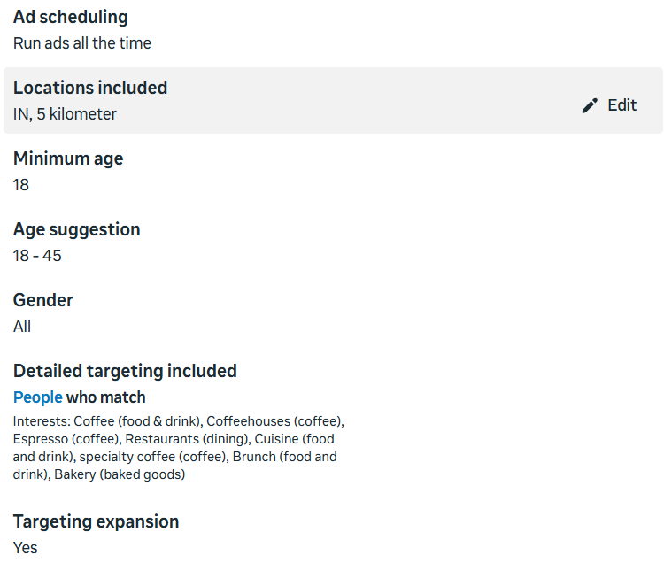
Target Audience
Local, interest-based targeting around the cafe's location
8.4M – 9.8M
Estimated Audience Size (Meta)
Location: 5 km radius, India (centered on the cafe)
Age: 18–45 | Gender: All
Interests: Coffee, Coffeehouses, Espresso, Restaurants, Cuisine, Specialty coffee, Brunch, Bakery
Targeting expansion: On, to help delivery within budget
Bean & Bloom Cafe — Facebook Ads Practice Campaign
4

Slide 5
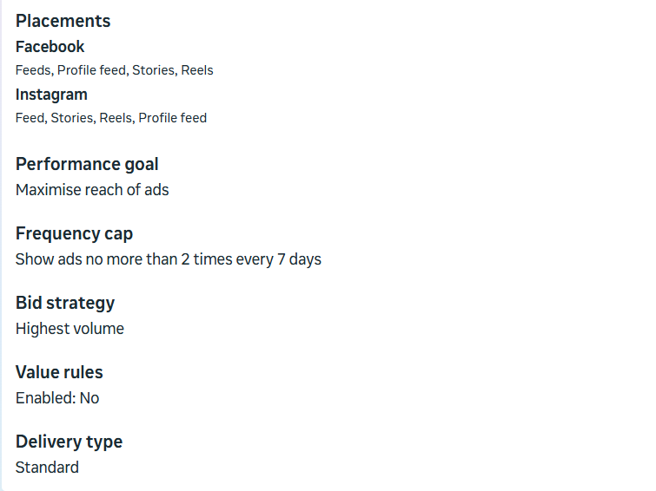
Placements & Delivery Settings
Manual placements across Facebook and Instagram
Facebook: Feeds, Profile feed, Stories, Reels
Instagram: Feed, Stories, Reels, Profile feed
Performance goal: Maximise reach of ads
Frequency cap: no more than 2 impressions per person every 7 days
Delivery type: Standard
Bean & Bloom Cafe — Facebook Ads Practice Campaign
5

Slide 6
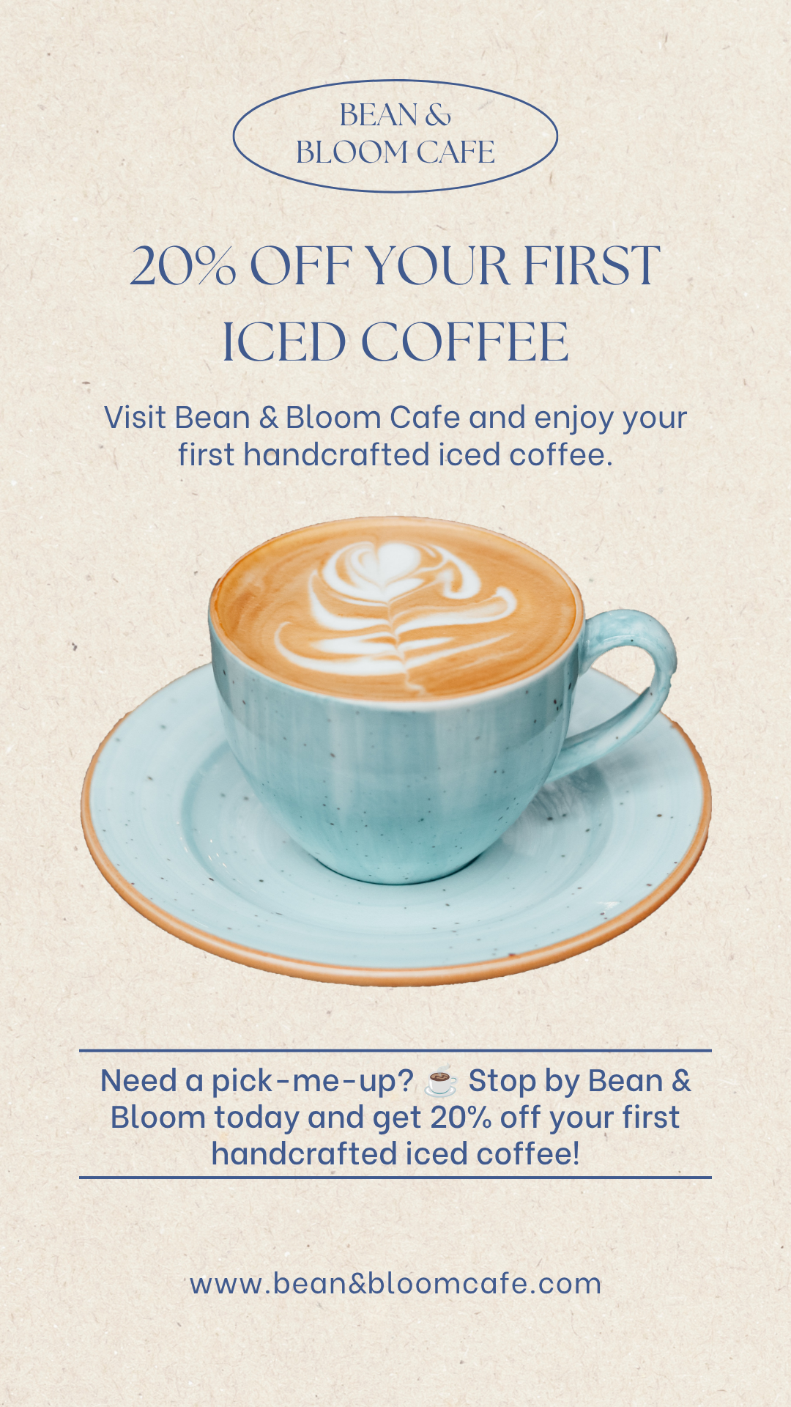
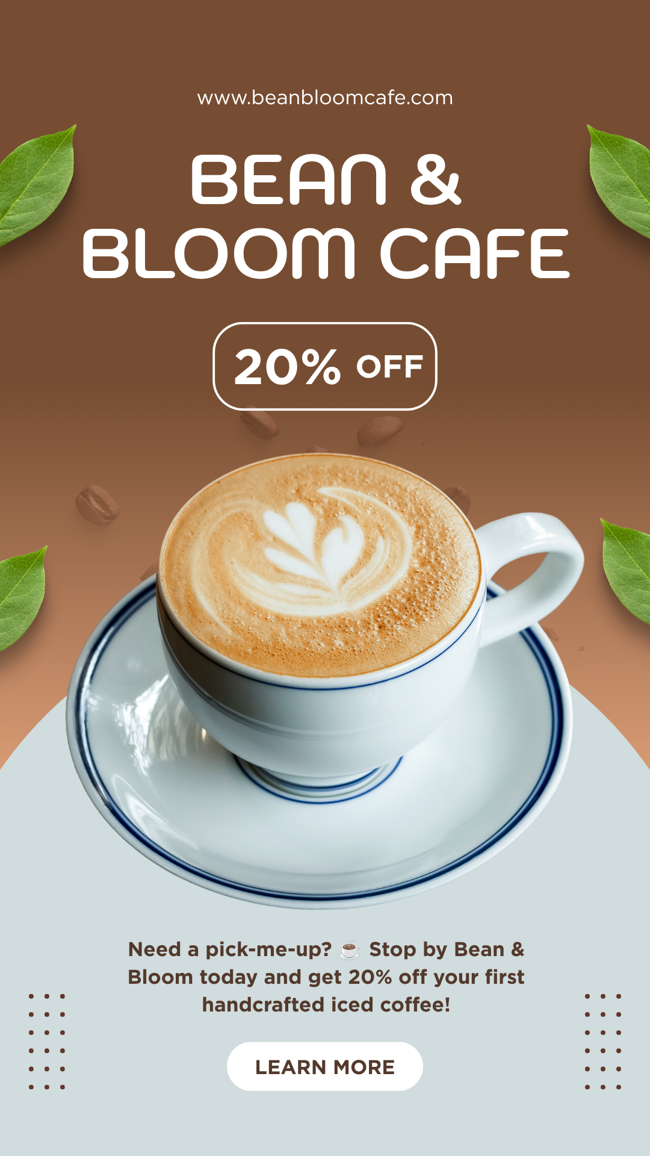
Ad Content Creation
Three creatives designed for Feed, Stories and Reels
Primary text: "Need a pick-me-up? ☕ Stop by Bean & Bloom today and get 20% off your first handcrafted iced coffee." Headline: "20% Off Your First Iced Coffee" CTA: Learn More
Feed
Stories
Reels
Ad format preference: Image ads were chosen over video or carousel. Static images let the offer be understood at a glance, need no video production, and suit all three placements (Feed, Stories, Reels) without multiple assets per carousel card. A carousel showcasing several menu items is a good next test.
Bean & Bloom Cafe — Facebook Ads Practice Campaign
6

Slide 7
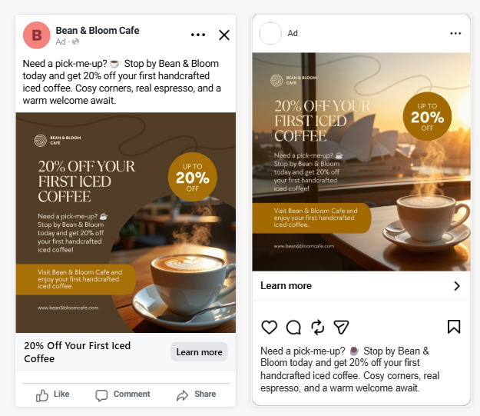
Ad Preview — Facebook & Instagram Feed
Ad preview as rendered in Meta Ads Manager
Square creative renders cleanly in Feed on both platforms. Full primary text, image, headline and CTA button are all visible — the strongest placement for this creative's layout.
Bean & Bloom Cafe — Facebook Ads Practice Campaign
7

Slide 8
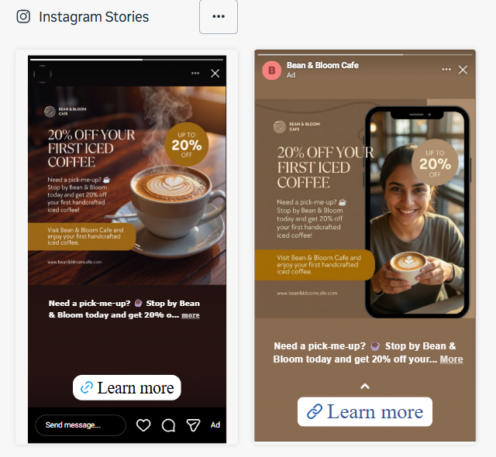
Ad Preview — Instagram & Facebook Stories
Ad preview as rendered in Meta Ads Manager
Vertical creative fills the Story frame well. Only a truncated line of primary text shows above the CTA — most of the message is carried by the image itself here.
Bean & Bloom Cafe — Facebook Ads Practice Campaign
8

Slide 9
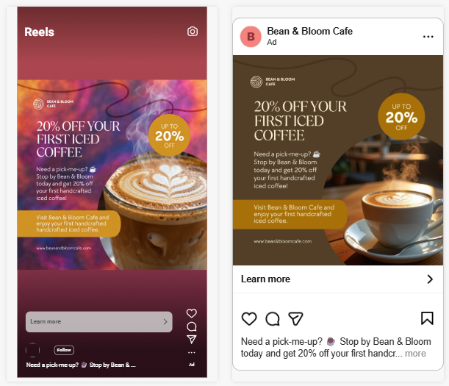
Ad Preview — Reels
Ad preview as rendered in Meta Ads Manager
The bold Reels creative stands out, but its own text sits close to the bottom where Meta's UI (caption, action buttons) can overlap it — a safe-zone issue worth correcting in a live campaign.
Bean & Bloom Cafe — Facebook Ads Practice Campaign
9

Slide 10
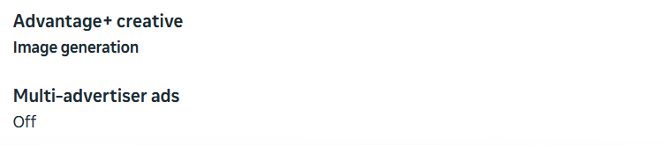
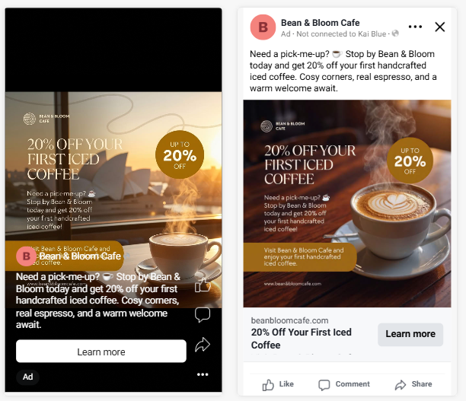
Observation: Advantage+ Creative (AI Image Generation)
An unplanned but useful learning point
Advantage+ Creative (Image generation) was on by default, so Meta auto-generated background variations of the original design.
Some preview variants replaced the original cafe-table background with a different AI-generated scene, changing the visual tone from what was actually designed.
Key takeaway: this setting should be reviewed and disabled when brand consistency matters, since it can alter creative without an explicit prompt.
Bean & Bloom Cafe — Facebook Ads Practice Campaign
10

Slide 11
Reflection & Key Learnings
Insights from building the campaign, not from live performance data
Meta's Estimated Audience Size (8.4M–9.8M) made clear how much reach targeting choices unlock — broad interests widen delivery but reduce precision.
Writing tight ad copy within character limits took more iteration than expected, especially for the headline.
Highest-volume bidding is the easiest starting point for a beginner, but a live campaign would benefit from testing cost-cap bidding once baseline data exists.
Creative consistency matters: the three ad designs used different fonts and color palettes, and Advantage+ Creative altered the image further — both are worth tightening in a real campaign.
Without an actual ad spend history, it isn't possible to validate real CTR or cost-per-result — a genuine limitation of a practice-only, unpublished setup.
Bean & Bloom Cafe — Facebook Ads Practice Campaign
11

Slide 12
Recommendations for a Future Live Campaign
Where this practice campaign could go next
Run a small live budget test (₹300–500/day for 5–7 days) to gather real CTR and cost-per-click data before scaling.
A/B test two ad creatives (e.g. interior shot vs. product close-up) to see which drives more engagement.
Standardize font and color palette across all creatives, and review Advantage+ Creative output before publishing.
Fix the Reels creative's text placement so it clears Meta's on-screen UI safe zones.
Use Meta Pixel (if a real website exists) to track link clicks and conversions more precisely.
Retarget people who engaged with the Page or previewed the ad, with a follow-up offer.
Bean & Bloom Cafe — Facebook Ads Practice Campaign
12

Slide 13
Thank You
Bean & Bloom Cafe — Facebook Ads Practice Campaign | Unified Mentor Capstone Project
Campaign was built and configured in Meta Ads Manager for learning purposes only and was not published or run live.

